Slide 1
Introduction to Computation
Fan Cheng Shanghai Jiao Tong University
http://www.cs.sjtu.edu.cn/~chengfan/
chengfan@sjtu.edu.cn
Autumn, 2022

Slide 2
Outline
Algorithm complexity
Exception

Slide 3

World with bugs
The most important thing to think about when designing and implementing a program is that it should produce results that can be relied upon

Slide 4

Correctness and Performance
Sometimes performance is an important aspect of correctness. This is most obvious for programs that need to run in real time. A program that warns airplanes of potential obstructions needs to issue the warning before the obstructions are encountered.

Slide 5
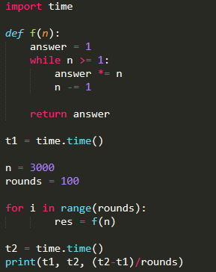
How to measure performance
Program = Algorithm + Data Structure
How to design efficient algorithm?
How to measure the complexity of Algorithm?
In Python, we can use the time module to study the running time of a program:
https://docs.python.org/3/library/time.html
We could run the program on some input and time it. But that wouldn’t be particularly informative because the result would depend upon
the speed of the computer on which it is run
the efficiency of the Python implementation on that machine
the value of the input
The time depends on the machine and system. How to measure its running time in theory?
It is cumbersome to use time.time() or timeit.timeit()
We need a theory to predict the future

Slide 6
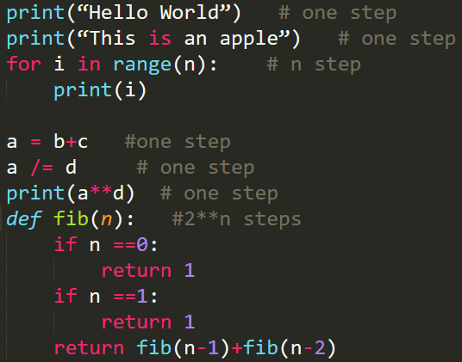
How to measure performance
Idea: computer programs consists of fundamental instructions like
+, -, *, /, //, %, if, =, print, input……
Regarded the running time of these instructions as “1”
For each program, just count how many fundamental instructions it contains
A step is an operation that takes a fixed amount of time, such as binding a variable to an object, making a comparison, executing an arithmetic operation, or accessing an object in memory
the number of steps may depend on the input

Slide 7
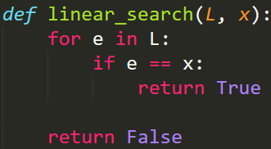
Worst-case Running Time
Both L and x will affect the running time
Best-case running time: the minimum running time over all the possible inputs of a given size
Worst-case running time: the maximum running time over all the possible inputs of a given size
Average-case running time: the average running time over all possible inputs of a given size

Slide 8
Asymptotic Notation
Observations: When n is large,
5n and 5n+2 are very close
1000000n and n² are very far away
We are concerned with n is very large in theory: the order（阶数） is more important
asymptotic notation: a formal way to talk about the relationship between the running time of an algorithm and the size of its inputs.
The underlying motivation is that almost any algorithm is sufficiently efficient when run on small inputs
What we typically need to worry about is the efficiency of the algorithm when run on very large inputs. As a proxy for “very large,” asymptotic notation describes the complexity of an algorithm as the size of its inputs approaches infinity
Summary
Not real time consumed by algorithms
Time approximated by steps.
If the size of input is large enough, asymptotic time complexity is accurate to compare the time complexity of algorithms
Understand time complexity is the foundation of computer science and engineering
From now on, when you write a program, you should be Very Very sensitive to the time complexity of your algorithm

Slide 9
“Big O” notation
The order of complexity is much more important
The asymptotic complexity of an algorithm:
If the running time is the sum of multiple terms, keep the one with the largest growth rate, and drop the others
If the remaining term is a product, drop any constants
The most commonly used asymptotic notation is called “Big O” notation. Big O notation is used to give an upper bound on the asymptotic growth (often called the order of growth) of a function
O(1) denotes constant running time
O(log n) denotes logarithmic running time
O(n) denotes linear running time
O(n log n) denotes log-linear running time
O(n^{k}) denotes polynomial running time. Notice that k is a constant
O(c^{n}) denotes exponential running time. Here a constant is being raised to a power based on the size of the input

Slide 10
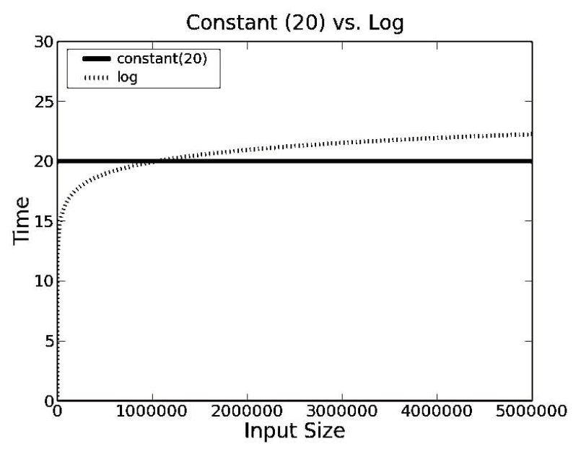
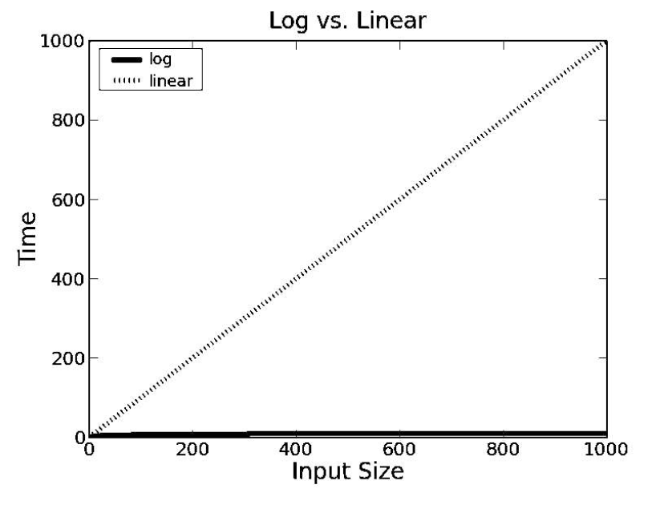
Comparisons of Complexity Classes

Slide 11
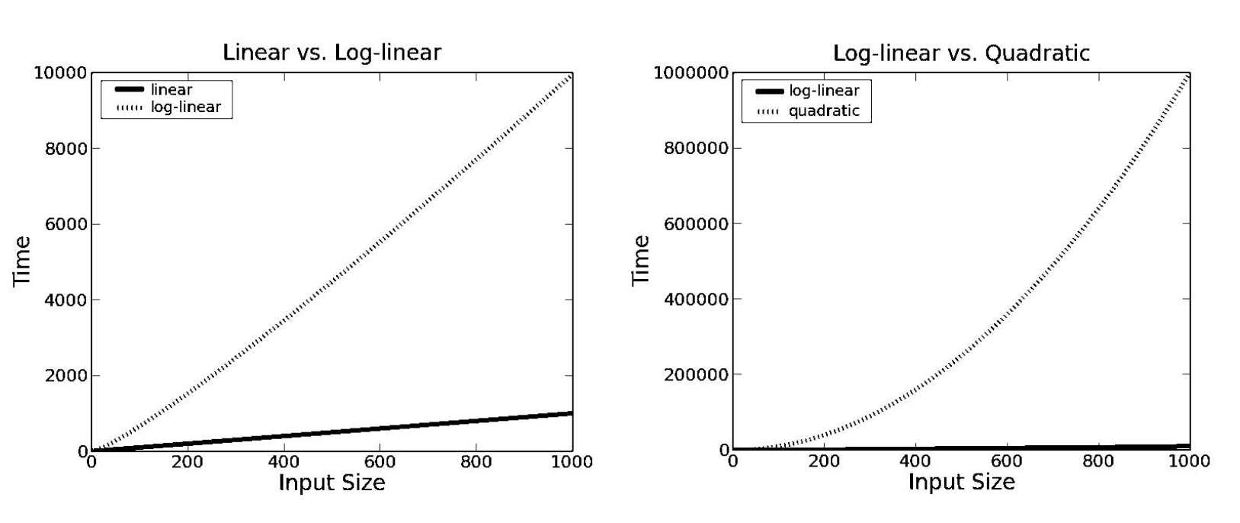
Comparisons of Complexity Classes

Slide 12
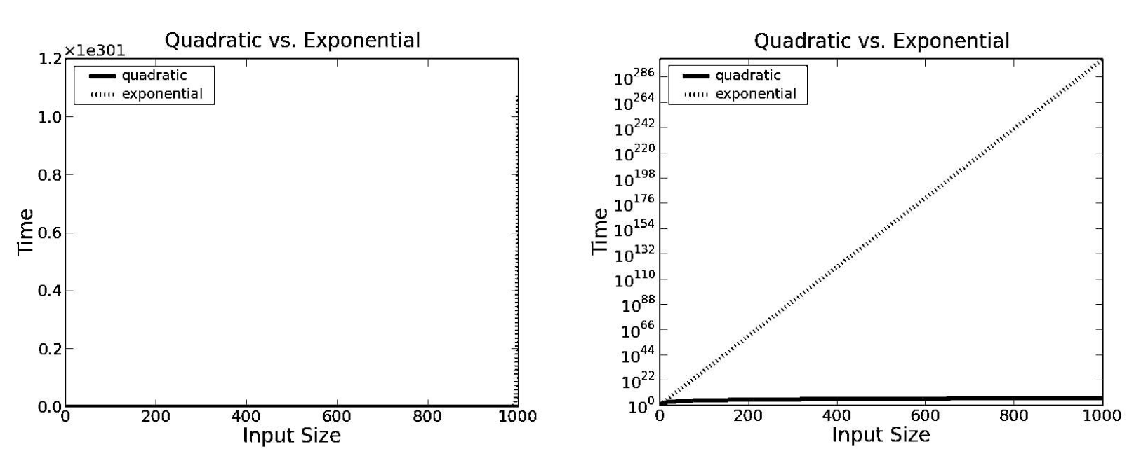
Comparisons of Complexity Classes
我们只关心算法的阶数

Slide 13
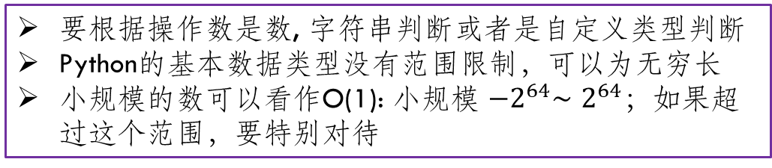
Complexity in Python statement
要根据操作数是数, 字符串判断或者是自定义类型判断
Python的基本数据类型没有范围限制，可以为无穷长
小规模的数可以看作O(1): 小规模 ${−2}^{64}∼2^{64}$；如果超过这个范围，要特别对待
=, +, -, *, /, //, %, +=, -/=…, **
>=, >, <=, <, ==, !=
not
if…elif…else
print(), input(): 取决于输入类型的长度. 一般是O(1)
math.sin(), math.cos()
return
复杂语法由其定义决定
while()
for()
自定义类、函数def f():

Slide 14
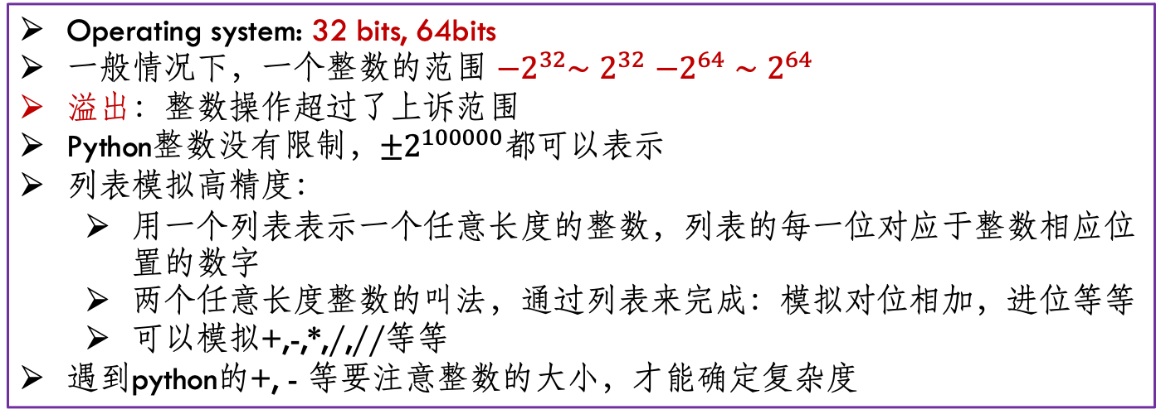
High Precision (高精度)
Operating system: 32 bits, 64bits
一般情况下，一个整数的范围 ${−2}^{32}∼2^{32}$ $−2^{64}∼2^{64}$
溢出：整数操作超过了上诉范围
Python整数没有限制，$±2^{100000}$都可以表示
列表模拟高精度：
用一个列表表示一个任意长度的整数，列表的每一位对应于整数相应位置的数字
两个任意长度整数的叫法，通过列表来完成：模拟对位相加，进位等等
可以模拟+,-,*,/,//等等
遇到python的+, - 等要注意整数的大小，才能确定复杂度

Slide 15
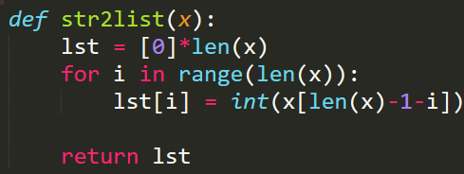
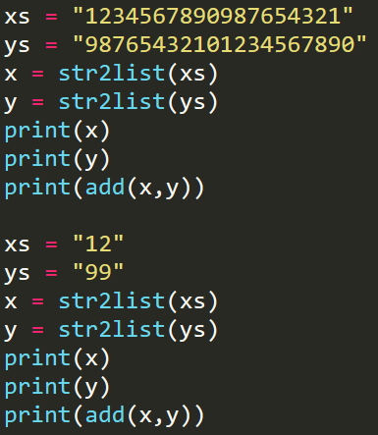
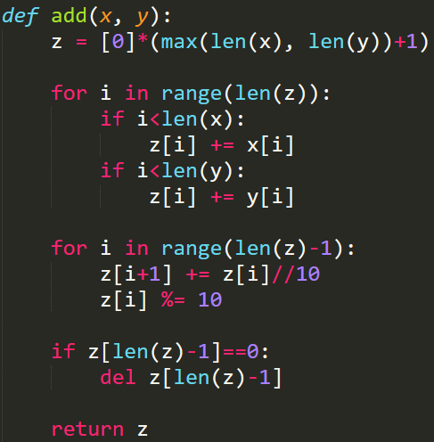
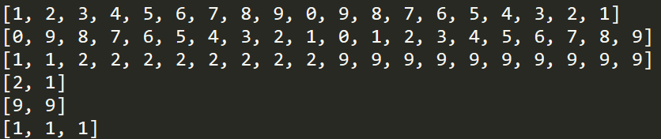
用字符串表示一个大整数
对位相加
进位
最高位进位
987
+ 123
1110

Slide 16
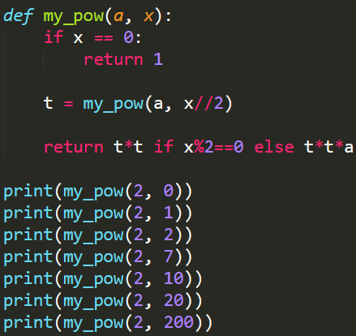
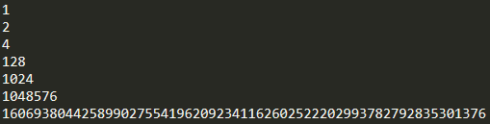
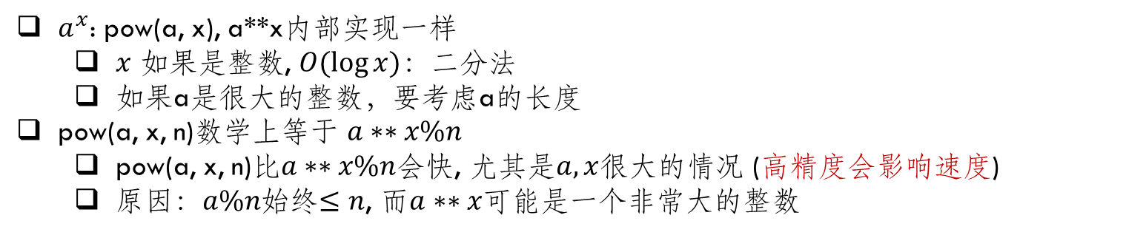
pow(), **
$a^{x}$: pow(a, x), a**x内部实现一样
$x$ 如果是整数, $O(\log{x})$：二分法
如果a是很大的整数，要考虑a的长度
pow(a, x, n)数学上等于 $a∗∗x\%n$
pow(a, x, n)比$a∗∗x\%n$会快, 尤其是$a, x$很大的情况 (高精度会影响速度)
原因：$a\%n$始终$≤n$, 而$a∗∗x$可能是一个非常大的整数

Slide 17
复合数据结构list, tuple, str, dict, set
100 | 2 | 3 | 4 | 5 | 7 | 8 | -1 | -3 | -7
list, tuple, str: 内存中，数据依次(consecutive)存储，排列成一行
list=[1,2,3,…,n]: 1 2 3 … n
如果列表嵌套、列表含有不同类型，需要单独分析
tuple=(1,2,3): 1 2 3 … n
str=“abc…z”: a b c … z
dict, set: 内部实现是hash table，需要更多的额外空间
插入、删除：
list, tuple, str: O(n) (tuple, str不能修改，而是建立一个新的变量)
删掉后，列表中不能有空位，要把所有后面的元素往前移一位
插入时，要把所有后面的元素往后移一位，然后插进去
dict, set: O(1)
查找：x in collection_a
list, tuple, str: O(n)
dict, set: O(1)
List.append(): O(1)

Slide 18
列表的复杂度
List Vs. Dict
列表的基本假设
列表中的元素在内存中是依次连续排列的
列表中的元素是通过下标访问的: lst[i]
访问一个元素是O(1)
在这两个假设下
插入 O(n)
查找 O(n)
删除 O(n)
100 | 2 | 3 | 4 | 5 | 7 | 8 | -1 | -3 | -7
依次连续排列才能保证通过下标访问
下标和元素一一对应

Slide 19
列表的复杂度
修改和插入很费时
不要一边遍历，一边修改
在基本假设下，如何自己实现插入、查找、删除 (用list模拟内存，list[i]第i个内存)
插入 O(n)
查找 O(n)
删除 O(n)
100 | 2 | 3 | 4 | 5 | 7 | 8 | -1 | -3 | -7
100 | 2 | 3 | 4 |  | 5 | 7 | 8 | -1 | -3 | -7
100 | 2 | 3 | 4 | 6 | 5 | 7 | 8 | -1 | -3 | -7
100 | 2 | 3 | 4 | 5 | 7 | 8 | -1 | -3 | -7
100 | 2 | 3 | 4 | 5 | 7 | 8 | -1 | -3 | -7
100 | 2 | 3 | 4 | 5 | * | 8 | -1 | -3 | -7
100 | 2 | 3 | 4 | 5 | 8 | -1 | -3 | -7

Slide 20
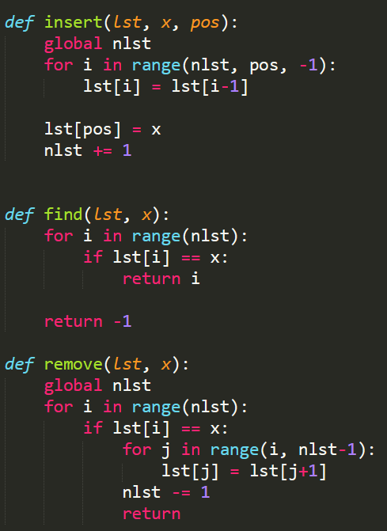
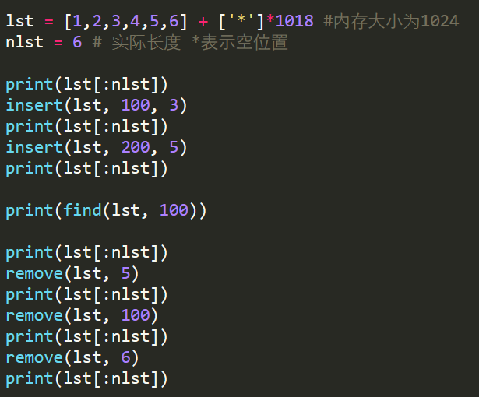
列表的复杂度
给一个1024长度的内存，模拟insert, remove, find

Slide 21
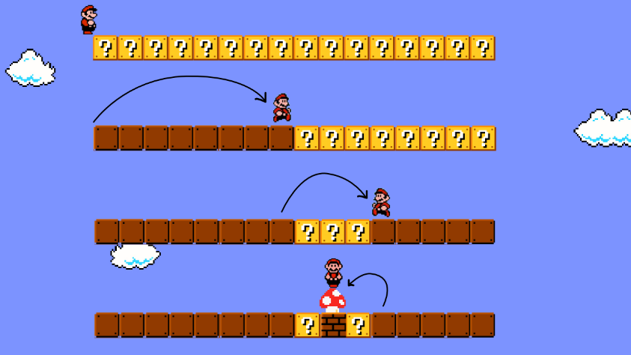
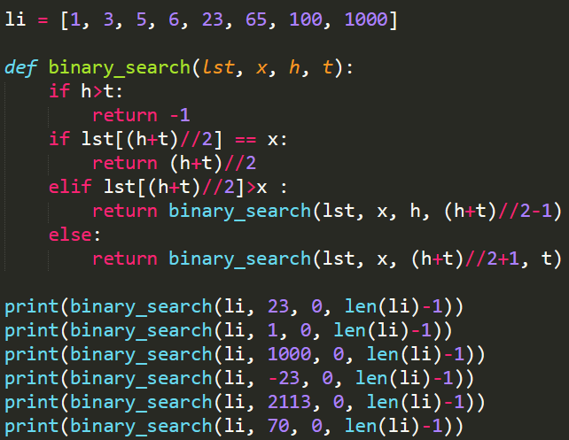
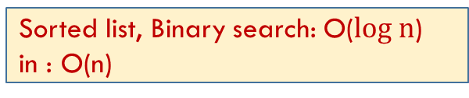
Binary Search
对于从小到大一个排好序的列表，每次和中间的元素比较，可以排除掉一半的元素
注意+1， -1
用while实现
Sorted list, Binary search: O($log n$)
in : O(n)

Slide 22
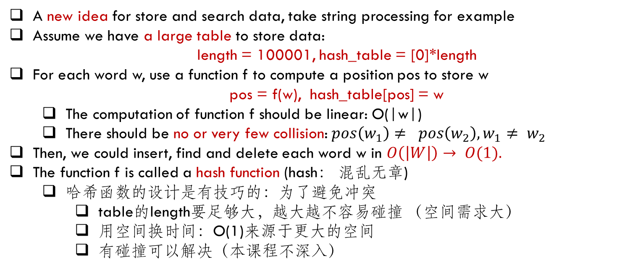
Hash (哈希) Table
-2 |  | 3
 | 100
 |  |  | -8
 |  | 7
预先准备一个表
需要时间和空间
对每个元素x, 用表中一个固定的位置pos(x)来存储
A new idea for store and search data, take string processing for example
Assume we have a large table to store data:
length = 100001, hash_table = [0]*length
For each word w, use a function f to compute a position pos to store w
pos = f(w), hash_table[pos] = w
The computation of function f should be linear: O(|w|)
There should be no or very few collision: $pos\left(w_{1}\right)≠ pos\left(w_{2}\right), w_{1}≠ w_{2}$
Then, we could insert, find and delete each word w in $O\left(\left|W\right|\right)→ O(1).$
The function f is called a hash function (hash： 混乱无章)
哈希函数的设计是有技巧的：为了避免冲突
table的length要足够大，越大越不容易碰撞 （空间需求大）
用空间换时间：O(1)来源于更大的空间
有碰撞可以解决（本课程不深入）

Slide 23
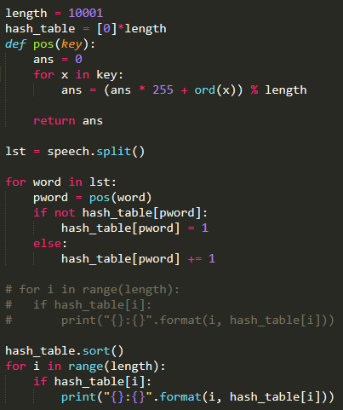
例子：实际中通过位置函数pos(x)来存储、查询
电影院直接告诉你座位在m排n列
宴会上会告诉你在第几桌几号位
不是顺序比较来查找
Hash table 的问题：初始化需要额外时间和空间
查找、插入、删除：O(1)
Python: __hash__()
尽量只初始化使用一个dict, set
dict(), set(): 插入、查找、删除都是 O(1)
List: 插入、查找、删除都是O(n)
Hash table 的问题：初始化需要时间和空间

Slide 24
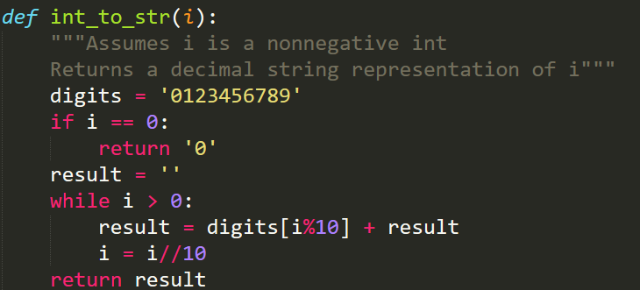
Example I

Slide 25
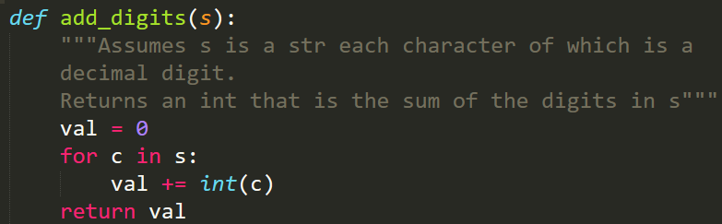
Example II

Slide 26
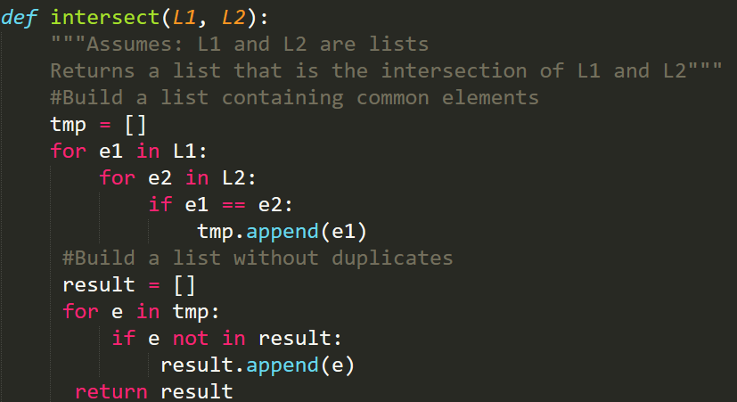
Example III

Slide 27
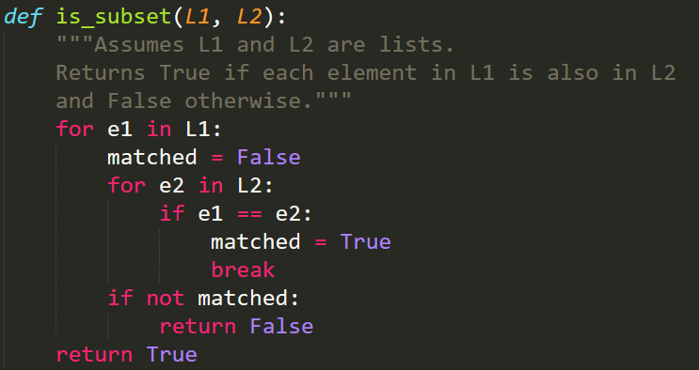
Example IV

Slide 28
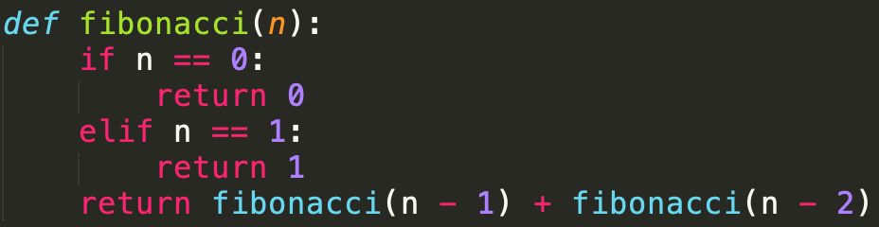

Example VI: Fibonacci sequence
Fib(n+2) = Fib(n+1) + Fib(n):
Time complexity $≈O(2^{n})$
$T\left(n+2\right)=T\left(n+1\right)+T\left(n\right)$
$T\left(n\right)=O\left({\left(\frac{1+\sqrt{5}}{2}\right)}^{n}\right)$
每个Fib(n)都被重复计算

Slide 29
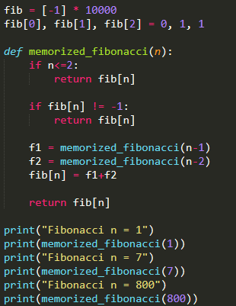
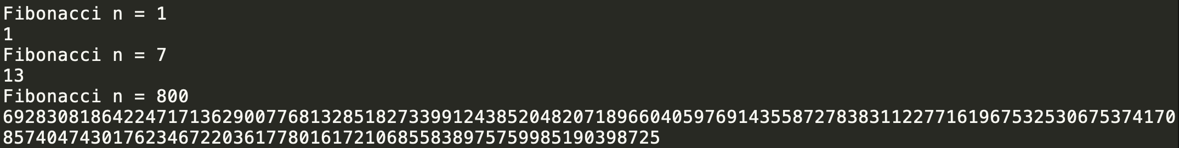
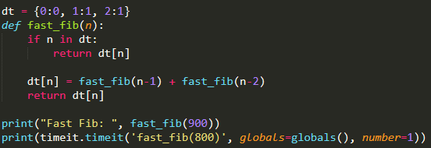
Example VI: Speed Up Fibo.
Tips: use a list (or dict) lst to store the intermediate results to speed up the computation
Each item in lst is initialized as -1
When invoke f(n), we could check lst[n] to see whether lst[n] had been computed before
If so, just return f(n)
Otherwise, we invoke the recursive function to compute f(n) and store it in lst[n]

Slide 30
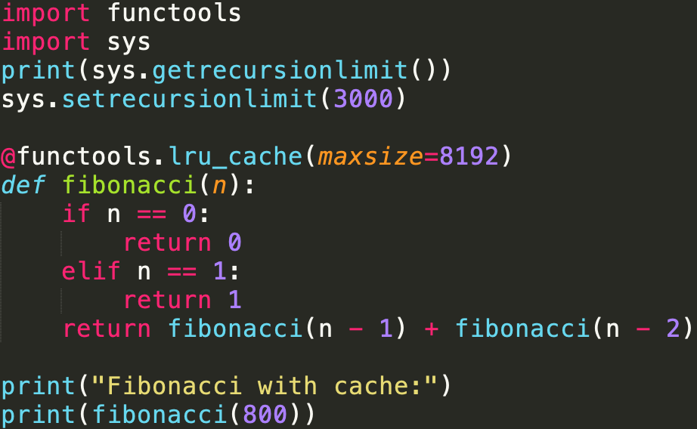
Python cache mechanism
仅供了解 ☺

Slide 31
Exercise
Fibonacci序列
gcd
合并两个list
合并两个排序好的list
测试list, set的效率
从时间复杂度可以类似的定义空间复杂度

Slide 32

Exception
异常

Slide 33
Even grammar is correct
>>> 10 * (1/0)
Traceback (most recent call last):
File "<stdin>", line 1, in <module>
ZeroDivisionError: division by zero
>>> 4 + spam*3
Traceback (most recent call last):
File "<stdin>", line 1, in <module>
NameError: name 'spam' is not defined
>>> '2' + 2
Traceback (most recent call last):
File "<stdin>", line 1, in <module>
TypeError: Can't convert 'int' object to str implicitly
It is not an error. It is an Exception
Your code is correct. Users do not follow your instructions.

Slide 34
Exception
Even if a statement or expression is syntactically correct, it may cause an error when an attempt is made to execute it. Errors detected during execution are called exceptions and are not unconditionally fatal
Most exceptions are not handled by programs, however, and result in error messages as shown here
The last line of the error message indicates what happened. Exceptions come in different types, and the type is printed as part of the message:
the types in the example are ZeroDivisionError, NameError and TypeError.
Built-in exceptions:
https://docs.python.org/3/library/exceptions.html#bltin-exceptions

Slide 35
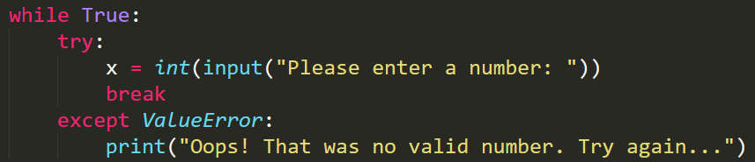
Handling Exception: Try except
Two keywords try and except
First, the try clause (the statement(s) between the try and except keywords) is executed. If no exception occurs, the except clause is skipped and execution of the try statement is finished
If an exception occurs during execution of the try clause, the rest of the clause is skipped. Then if its type matches the exception named after the except keyword, the except clause is executed, and then execution continues after the try statement
If an exception occurs which does not match the exception named in the except clause, it is passed on to outer try statements; if no handler is found, it is an unhandled exception and execution stops with a message as shown above

Slide 36
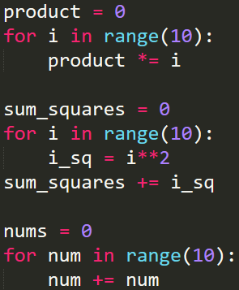

Exercise
Find potential sources of runtime errors in this code snippet:
dividend = float(input("Please enter the dividend: "))
divisor = float(input("Please enter the divisor: "))
quotient = dividend / divisor
quotient_rounded = math.round(quotient)
for x in range(a, b):
print("({},{}, {})“.format( my_list[x]))
Find potential sources of logic errors in this code snippet:
Add a try-except statement to the body of this function
which handles a possible IndexError, which could occur if
the index provided exceeds the length of the list. Print an
error message if this happens:

Slide 37
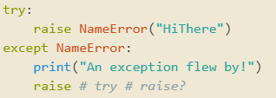
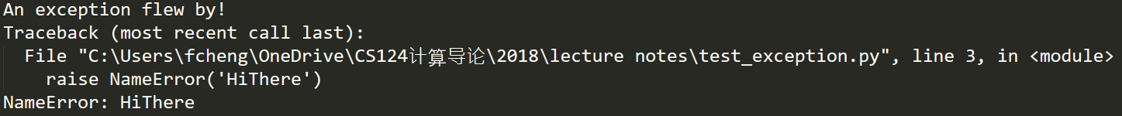
Raise
The raise statement allows the programmer to force a specified exception to occur.
>>> raise NameError('HiThere')
Traceback (most recent call last):
File "<stdin>", line 1, in <module>
NameError: HiThere
>>>raise ZeroDivisionError()
>>>raise ZeroDivisionError
>>>raise TypeError
>>>raise TypeError()
>>>raise ValueError
If you need to determine whether an exception was raised but don’t intend to handle it, a simpler form of the raise statement allows you to re-raise the exception:

Slide 38
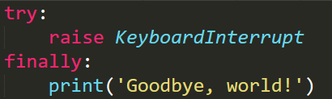
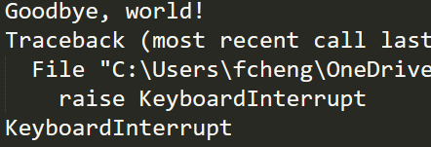
Clean up: try … finally
The try statement has another optional clause which is intended to define clean-up actions that must be executed under all circumstances.
A finally clause is always executed before leaving the try statement, whether an exception has occurred or not.
When an exception has occurred in the try clause and has not been handled by an except clause (or it has occurred in an except or else clause), it is re-raised after the finally clause has been executed.
The finally clause is also executed “on the way out” when any other clause of the try statement is left via a break, continue or return statement.
As you can see, the finally clause is executed in any event. The TypeError raised by dividing two strings is not handled by the except clause and therefore re-raised after the finally clause has been executed.
In real world applications, the finally clause is useful for releasing external resources (such as files or network connections), regardless of whether the use of the resource was successful.

Slide 39
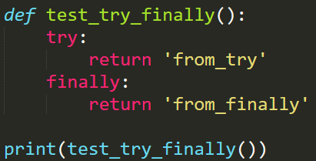

Slide 40
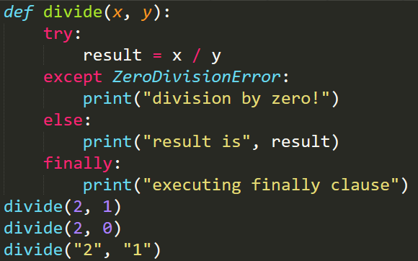
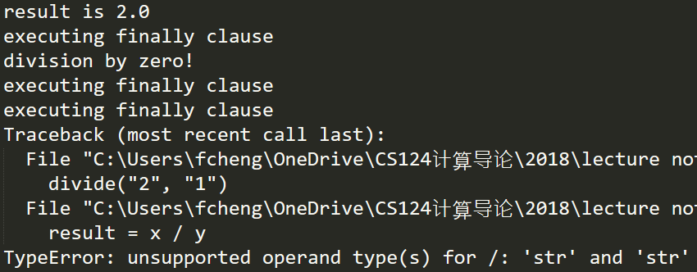
Exception
The try … except statement has an optional else clause, which, when present, must follow all except clauses. It is useful for code that must be executed if the try clause does not raise an exception.
The use of the else clause is better than adding additional code to the try clause because it avoids accidentally catching an exception that wasn’t raised by the code being protected by the try … except statement.
else will be executed only if the try clause doesn’t raise an exception

Slide 41
Predefined Clean-up Actions
Some objects define standard clean-up actions to be undertaken when the object is no longer needed, regardless of whether or not the operation using the object succeeded or failed. Look at the following example, which tries to open a file and print its contents to the screen.
for line in open("myfile.txt"):
print(line, end="")
The problem with this code is that it leaves the file open for an indeterminate amount of time after this part of the code has finished executing. This is not an issue in simple scripts, but can be a problem for larger applications.
The with statement allows objects like files to be used in a way that ensures they are always cleaned up promptly and correctly.
with open("myfile.txt") as f:
for line in f:
print(line, end="")
After the statement is executed, the file f is always closed, even if a problem was encountered while processing the lines. Objects which, like files, provide predefined clean-up actions will indicate this in their documentation

Slide 42
More on try and except
A try statement may have more than one except clause, to specify handlers for different exceptions.
At most one handler will be executed. Handlers only handle exceptions that occur in the corresponding try clause, not in other handlers of the same try statement.
An except clause may name multiple exceptions as a parenthesized tuple, for example:
... except (RuntimeError, TypeError, NameError):
... pass #do nothing
pass: It is used when a statement is required syntactically but you do not want any command or code to execute. The pass statement is a null operation; nothing happens when it executes. The pass is also useful in places where your code will eventually go, but has not been written yet
The last except clause may omit the exception name(s), to serve as a wildcard. Use this with extreme caution, since it is easy to mask a real programming error in this way! It can also be used to print an error message and then re-raise the exception (allowing a caller to handle the exception as well):

Slide 43
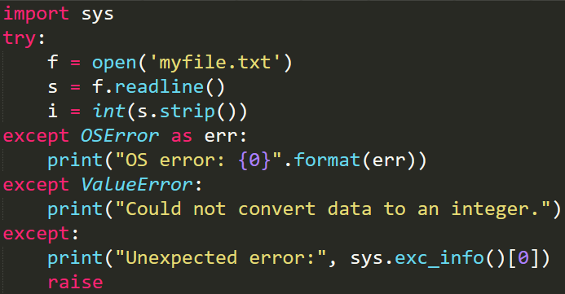

Slide 44
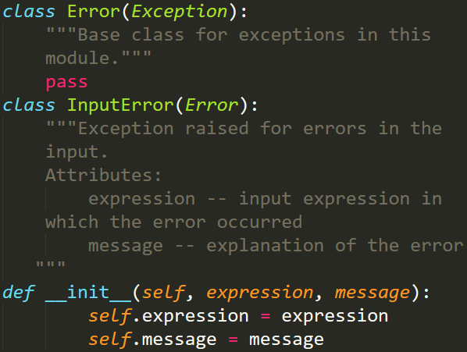
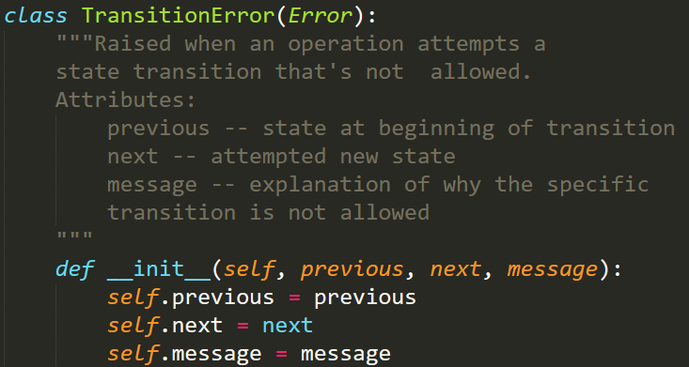
User Defined Exception
仅供了解 ☺
Programs may name their own exceptions by creating a new exception class (see Classes for more about Python classes). Exceptions should typically be derived from the Exception class, either directly or indirectly.
Exception classes can be defined which do anything any other class can do, but are usually kept simple, often only offering a number of attributes that allow information about the error to be extracted by handlers for the exception.
When creating a module that can raise several distinct errors, a common practice is to create a base class for exceptions defined by that module, and subclass that to create specific exception classes for different error conditions:

Slide 45
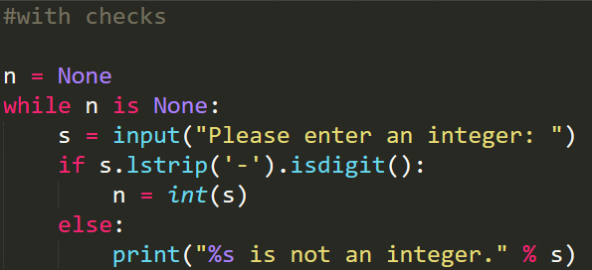
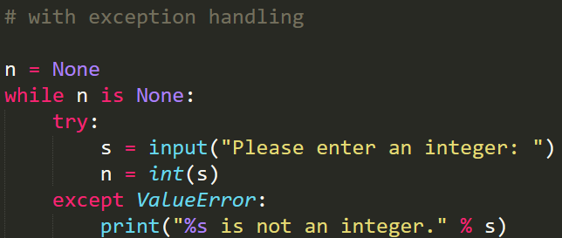
Error checks vs exception handling

Slide 46
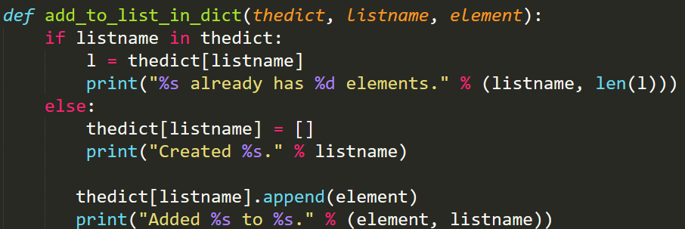
Exercise
This function adds an element to a list inside a dict of lists. Rewrite it to use a try-except statement which handles a possible KeyError if the list with the name provided doesn’t exist in the dictionary yet, instead of checking beforehand whether it does. Include else and finally clauses in your try-except block:

